Slide 1
Major Oobage
Cheryl Lee
Nicolas Huang

Slide 2
Major Oobage
Dating website
allows people to meet other singles online.

Slide 3
Target audience
Students from the 4 local universities: NUS, NTU, SMU and SUTD

Slide 4
Problem with current dating websites
You do not trust the people out there and are therefore hesitant to meet up with those that you find online.
Solution:
Only people from the 4 local universities can see each other.
Users log in with their school emails.

Slide 5
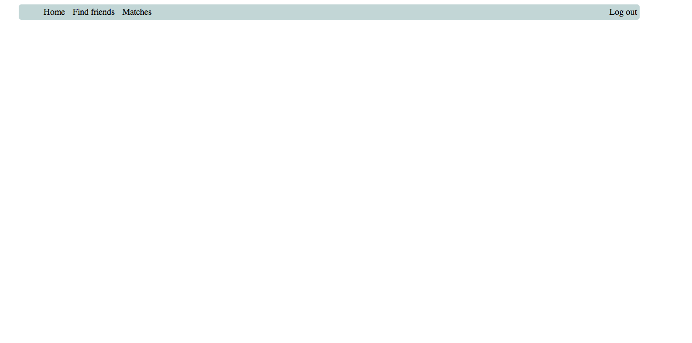

Slide 7

Dear Ron,
Would you like to meet up with her?
YES NO
Serina Wee

Slide 8
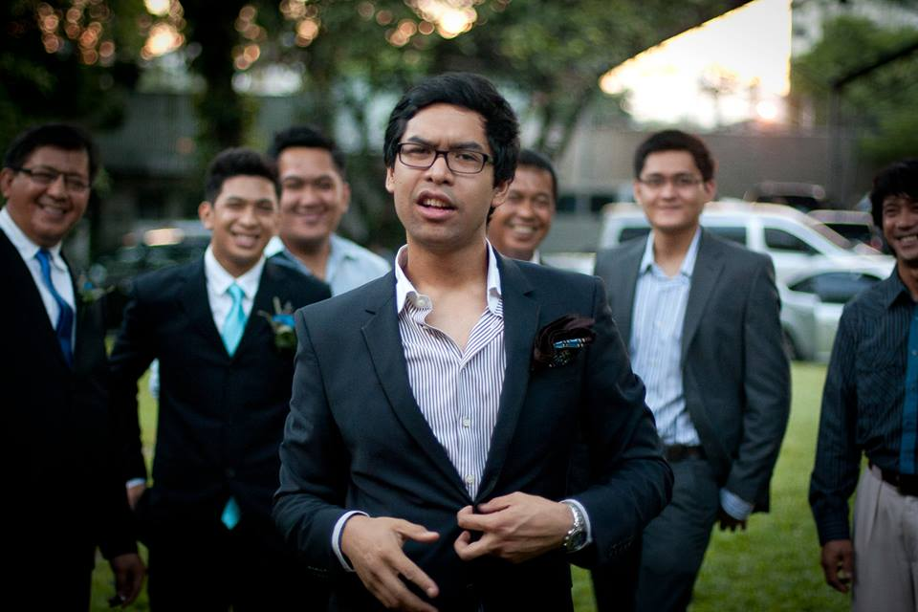
Dear Serina Wee,
Would you like to meet up with him?
YES NO
Ron

Slide 10
You have indicated that you would like to meet Serina Wee. Guess what? She wants to meet you too! Here are her contact details:
HP: 90105544
Email: serina_wee@gmail.com

Slide 11
You have indicated that you would like to meet Ron. Guess what? He wants to meet you too! Here are his contact details:
HP: 92225544
Email: ron_carlos@gmail.com

